Slide 1
How to search for English papers
Gifu University Library
Notes:
Good Afternoon. Thank you for coming to the library seminar.
We will explain how to look for English research papers in this course.
My name is ○○. I am a library staff.

Slide 2
Today’s flow
1. How to understand the notation
of references
2. How to identify the desired papers
3. How to get the research papers
Notes:
Today we will explain mainly 3 topics, about learning the notation of research papers, searching method, and how to get the paper.

Slide 3
How to understand the notation
of references
2. How to identify the desired paper
3. How to get the research papers
Notes:
First we will explain how to understand notation of research papers.

Slide 4
The notation of the references
＜Examples of references＞
Asselin BL, Ryan D, Frantz CN, et al. In vitro and in vivo killing of acute lymphoblastic leukemia cells by L-asparaginase. Cancer Res. 1989;49:4363-4368.
⇒Author, Title, Journal, Year, Volume, Page
Mas-Torrent, M.; Durkut, M.; Hadley, P.; Ribas, X.; Rovira, C. J. Am. Chem. Soc. 2004, 126, 984–985.
⇒Author, Journal, Year, Volume, Page
Glodowski, D.R., Chen, C.C., Schaefer, H., Grant, B.D., and Rongo, C. (2007).RAB-10 regulates glutamate receptor recycling in a cholesterol-dependent endocytosis pathway. Mol. Biol. Cell 18, 4387–4396.
⇒Author, Year, Title, Journal, Volume, Page
The name of author comes first.
“et.al.” means there are other authors but are not noted here.
Title of paper might not be shown.
Most of the notation contains initial of each term of journal title in capital letter as short form. Font might also be changed.
Notes:
Understanding the notation of reference is necessary when looking for research papers.
Usually it is written in order of the author, title of paper, journal, year of publishing, volume, issue and page.
On the 1st example of this page all information are listed in the correct order.
Usually the name of author comes first and sometimes the title of paper is not noted.
Journal title is often be shortened and the initial of each term are written in capital letters.
For examples, the full journal title in the 1st example is Cancer Research, the 2nd is Journal of American Chemical Society, and the 3rd is Molecular biology of the cell.
Journal title might be italic or other fonts.
Simple notation also exists which only contain the short term of journal title, volume, page and year.
Et al. is Latin word which means "and others" in English.

Slide 5
Notation of research paper
ISSN：
Short form of International Standard Serial Number.
Journals and newspapers only contain 8 digits.
To look for papers in library...
①Search for the journal title by database(easier if ISSN is known),
②Check whether the journal where the paper is published is owned by library or not,
③Get the journal.
Information below is necessary for searching work
Author・Journal・Volume・Page
⇒Zaman, K. et al. N. Engl. J. Med. 359, 1555-1564
Notes:
When you search papers in library, first we use the OPAC database system and search for the journal title.
It will be easier to find if you also know the ISSN.
ISSN stands for International Standard Serial Number, for journal and newspaper there are given the fixed 8 numbers.
Next, make sure that library holds the volume and issue of journal which the paper is posted, and you may proceed to the bookshelf.
If you know more information such as author, journal title, volume and page number, it will be much easier to specify the paper.

Slide 6
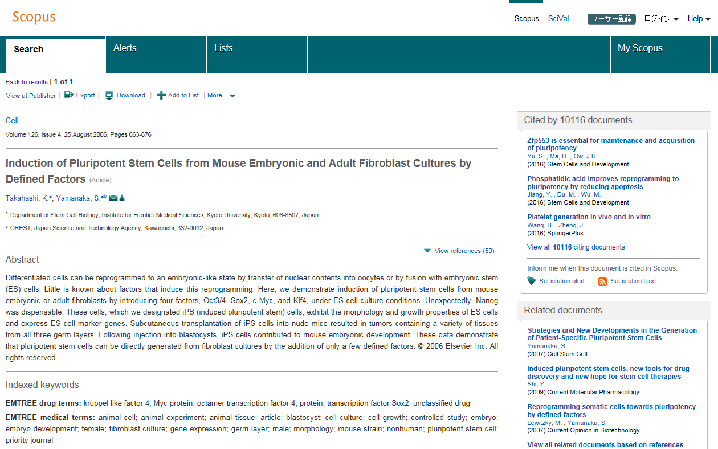
Notation of research paper
In the case of Scopus
Search result of database
Journal・Volume・Page
Title
Author
Journal⇒CELL
Volume ⇒126(4)
Page ⇒663-676
Author ⇒Takahashi, Kazutoshi ; Yamanaka, Shinya
Notes:
Now we are showing an example of the search result on Scopus. Scopus is one of the database search engine that subscribed by Gifu University.
In this page we can see some details such as the paper title, author, journal title and page number.

Slide 7
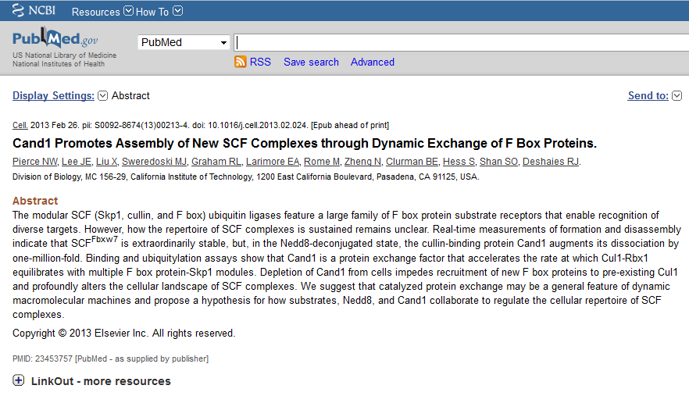
A paper exhibited on the web before publication
Title
Author
Journal⇒Celｌ Publishing year&month⇒2013 Feb Volume⇒？ Page⇒？
Epub ahead of print⇒
This is research paper posted on electronic journal ahead of printing in journal.
No volume and page is noted because it's not published yet.
「Published Online」 「Early View」 「Advance Online Publication」 「Articles in Press」
Notes:
Nowadays there are a few of electronic journals posting research papers before they get published such as Epub and ahead of print.
Please note that no information about the page number of papers, and these papers can only be read on electronic journals.
If fail to use the electronic journals, try to make a photocopy request to the library which we will be explaining the procedure later on.
This kind of research paper will be also published in the journal after a couple months.

Slide 8
How to understand the notation
2. How to identify desired paper
3. How to get the paper
Notes:
Next we will talk about searching method.

Slide 9
3ways to find out desired papers
Using of reference
  Trace by reference paper had on hand
Browsing
  Search the bookshelves under the same category
Database search
  Use keywords to search
  ・Available database such as Scopus
Notes:
There are 3 ways to look for desired papers which is using of reference, browsing and database search.

Slide 10

(1) Using of reference
Based on you had on hand to look for
more sources
＜References＞
・……
・……
・……
Quoted reference= Valuable source of reference
Notes:
Chaining means that searching other papers based on the reference information noted in papers.
By this method, you can efficiently trace the older paper faster and easier from the very first piece of paper.
However, please note that it's necessary to start from the paper with good quality and the latest version in order to trace successfully.

Slide 11
(2) Browsing
Books and journals are placed separately according to categories
Books
Serials
By looking on the surrounding’s bookshelves, you may have new discovery !
NDC（excerpt）
000 General works
100 Philosophy
200 General history
300 Social science
400 Natural science
500 Technology. Engineering
600 Industry and commerce
700 The arts. Fine arts
800 Language
900 Literature
Discipline
Natural science
Human and social sciences
Bulletin and report
etc.
Notes:
Browsing means that finding books by looking around bookshelves.
In the library of Gifu University, books and journals are placed separately according to categories and fields. Let’s look around the shelves when you go looking for books. It may give you new discoveries.

Slide 12
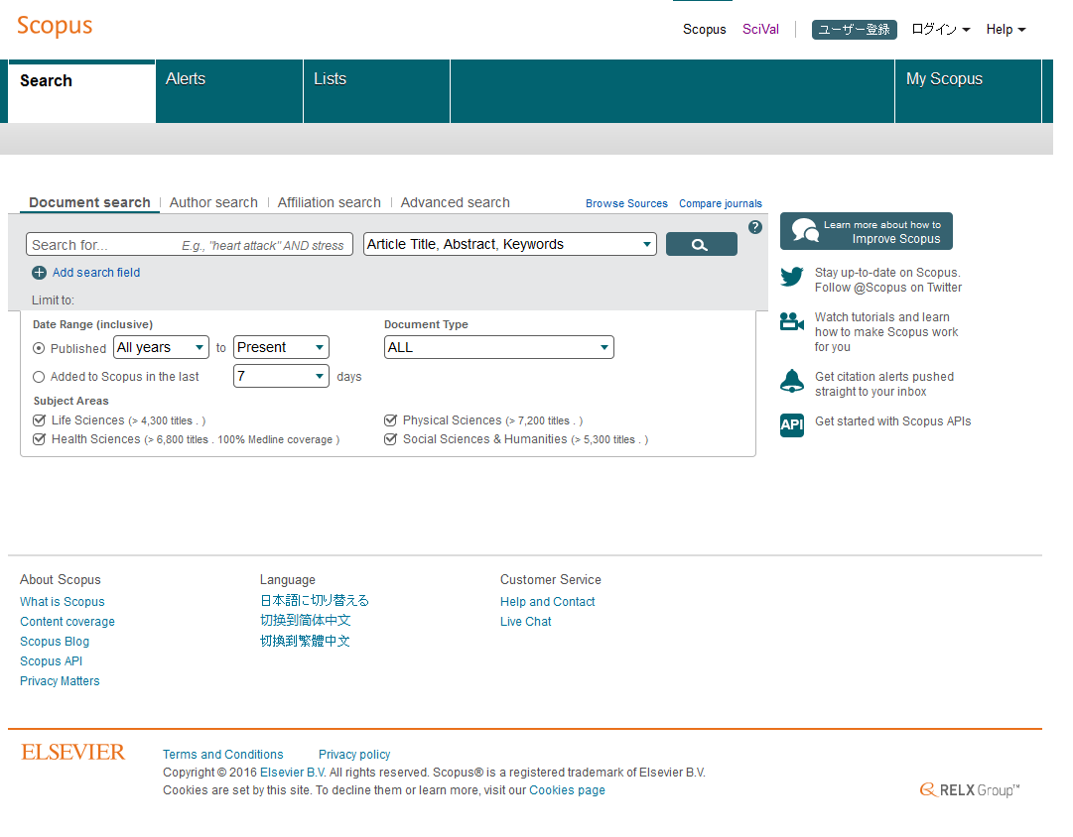
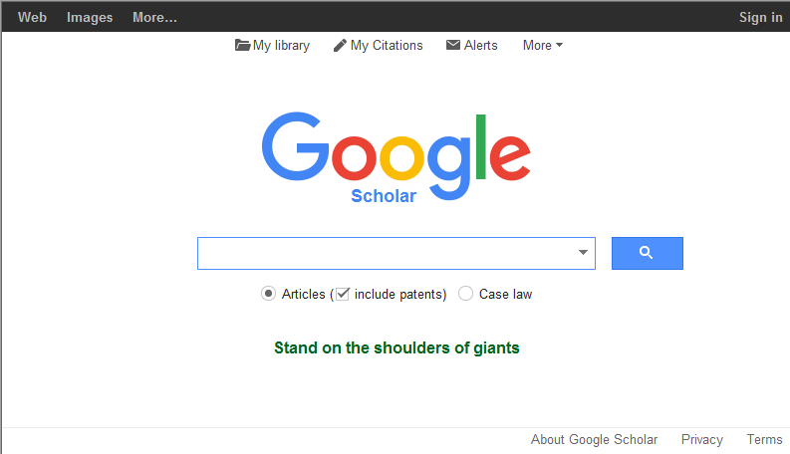
(3) Database search (index + text)
Information like title, author, journal, volume, page can be found in database.
By keying in the keywords, you can find out what kind of papers they have in database, and information needed when searching for desired paper.
Notes:
The third way to look for research paper is database search. You may use computer to search.
Once the database was used as an index to search by keyword, but now some of database can even show the content of the papers.

Slide 13
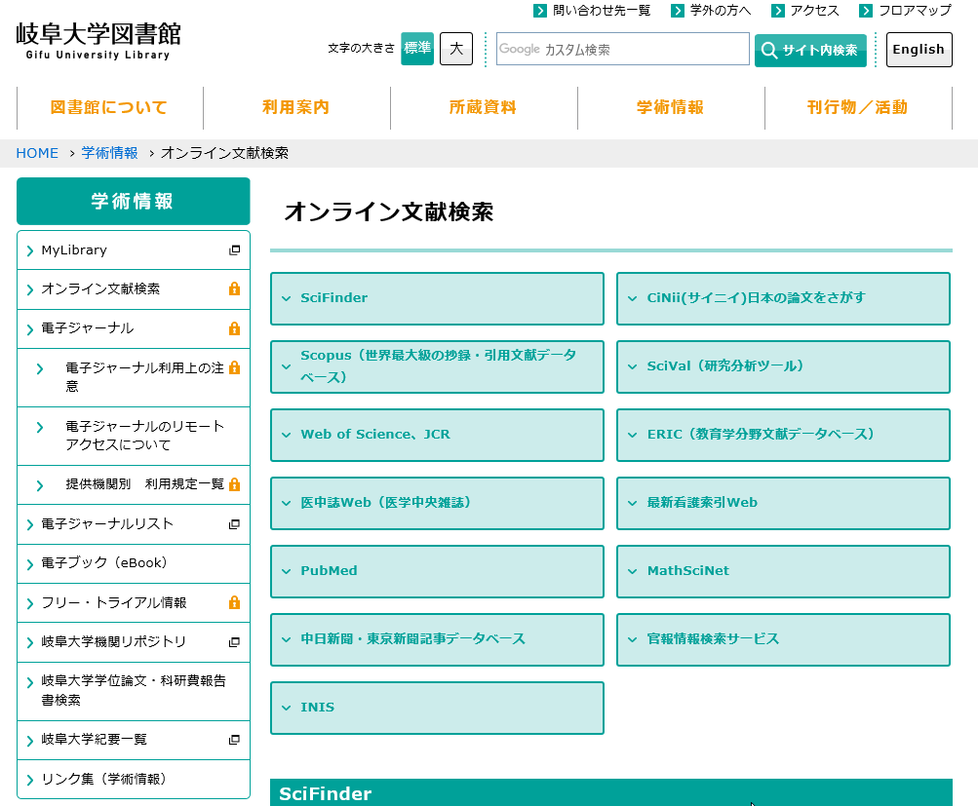
Databases available in Gifu university
Library’s Website
Databases available
within university
・SciFinder Scholar
・Scopus
・MathSciNet
Databases available
outside the university
・Google Scholar
・PubMed
and etc.
Notes:
Databases that can be used within the university compound is listed on the website of the library.
You can use SciFinder, Scopus and MathSciNet on campus.
You may use Google Scholar and PubMed anywhere and for free.

Slide 14
Now try to use Scopus
Scopus
・Scopus is the world’s largest abstract and citation database, covering research topics across all scientific and technical disciplines, ranging from medicine and social sciences to arts and humanities.
・Scopus contains more than 22,000 title of Journal and 50,000 title of books.
Notes:
When you have decided the keywords, you may proceed to search.
There is an English database called Scopus collaborated with Gifu University.
Scopus contains the main journals from every fields. There are some research papers that contain links to the original text. No limit to the number of access at the same time.

Slide 15
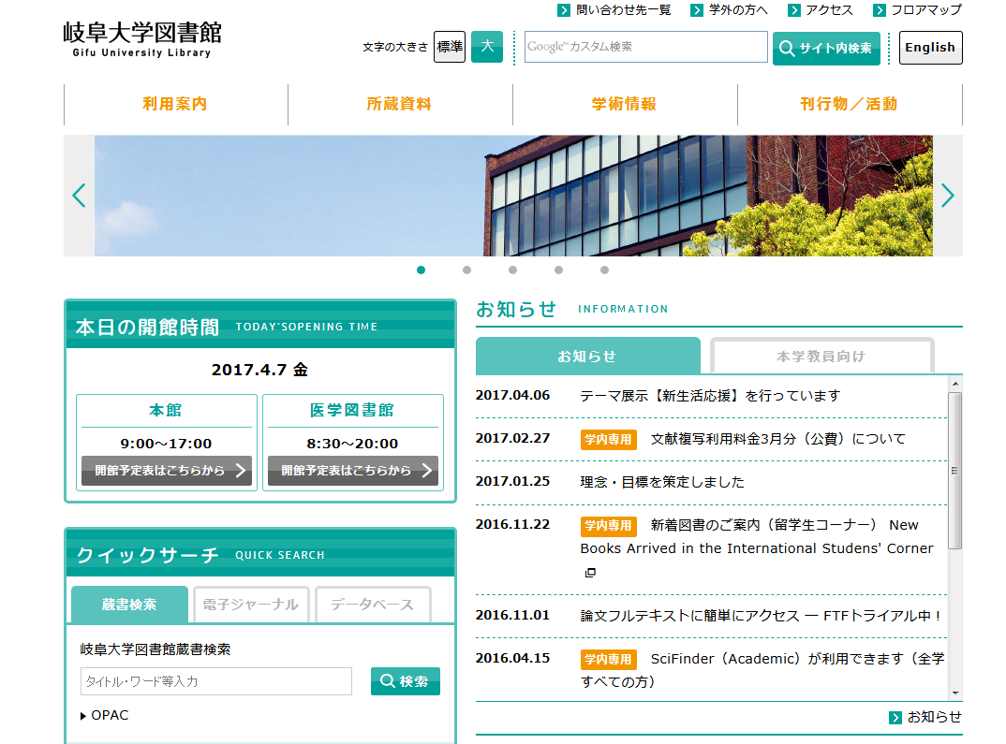
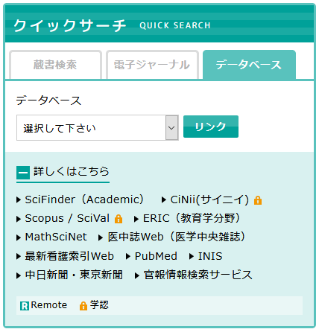
Ways to access to Scopus
Notes:
If you wish to access to Scopus, you can find the link on Gifu university library homepage.
There are other databases which are specific to medical, mathematics, and other fields, you may check them out later.

Slide 16
The help desk contains information about methods of searching.
For examples,
【OR search】
「△OR△」(OR in half-width・capital letter/small letter)
【NOT search】
「AND△NOT△」(AND NOT in half-width・capital letter/small letter)
Search for name of author by initials
For prefix search use＊(half-width asterisk)
To search by author name in initial only, and term in singular/plural form ex. Yamada T* and cell* etc.
Notes:
We will explain the flow of search by using Scopus.
For searching the papers by author name, use the prefix search and remember to add asterisk after the single word.
There are designation of keywords such as OR and NOT search. Any enquiry please refer to the help desk.

Slide 17
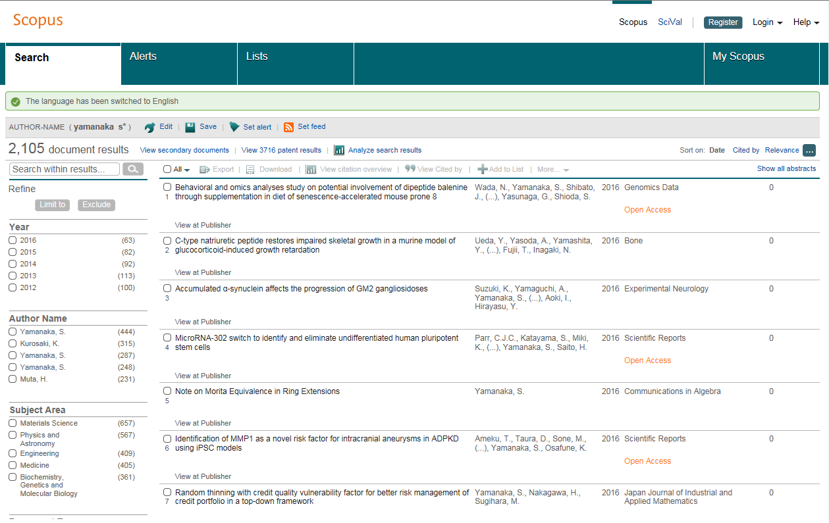
Search results
Title, author, year
Notes:
This is the search result.
Not only can read the abstract of the research paper, but we can also obtain the information needed upon searching or purchase, such as title, author, journal, volume and page.

Slide 18
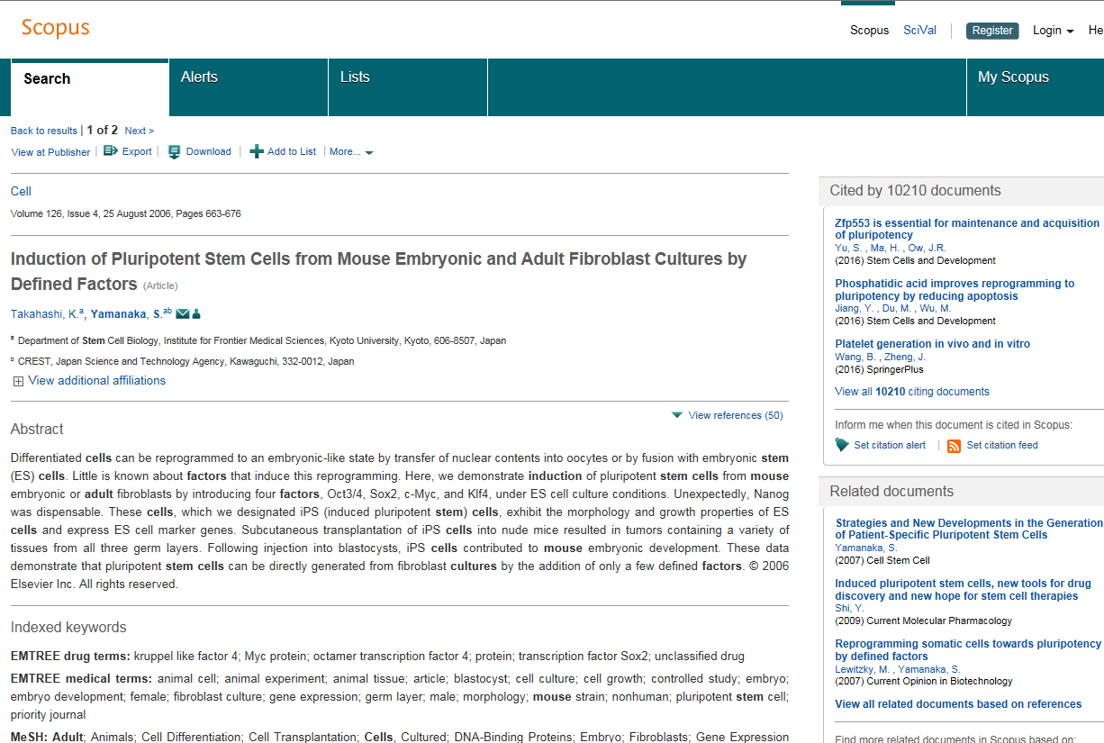
Details of Search Result
Title, author, journal, volume,
page, year and etc.
Notes:
As clicking open one of the papers, it shows the details.

Slide 19
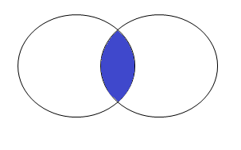
Keywords are important!
Too many search results...
Specify target with more keywords by using 「AND search」
Extract the important ones by「NOT search」
Use the phrase search(quote byhalf-width ””）Ex.” Gifu University”
＜AND search＞
＜NOT search＞
Japan AND Asia
Japan NOT Asia
Refer to the help desk for further information.
Notes:
Please be aware that keywords are important when coming to searching of papers. Once mistakes are made in the keywords, there will be too many search results or no search result being shown.
In the process of studying and researching, we believe that you can understand and remember the way of using keywords.
The AND search is just like using Google, key in a few keywords and the search result includes all the keywords. But if there are too many unrelated results, the NOT search can be used to cut down the unrelated results.
To fix the sequence of keywords, the phrase search can be used by marking the keywords with ””in the most of database, but please note that some databases may have different rules.
For more information please refer to help desk of each database.

Slide 20
Keywords are important!
No search result...
Try to use synonyms or broader terms for「OR search」
Synonym: Different word with same or similar meaning
Broader term: Word with wide range of meaning
＜OR search＞
＜Synonym＞
Carbon dioxide＝CO2
＜Broader term＞
Oxygen ＜ Element
Japan OR Asia
Refer to the help desk for further information.
Notes:
If no desired results shown it is necessary to change the previous keywords in order to get successful hit.
By OR search try using same and broader meaning but different words, it’s more likely to get more search results.

Slide 21
1. How to understand the notation
of references
2. How to identify the desired papers
3. How to get research papers.
Notes:
Next we will be talking about how to get research paper.

Slide 22
Get the papers
Check the books owned by Gifu university using OPAC.
１、Journals in library
２、Electronic journals under contract with university
If none of them works
３、Get it from outside of the university
(Extra)Free journal is also available on the Internet
→Google Scholar
Notes:
This slide shows a few methods to obtain research papers

Slide 23
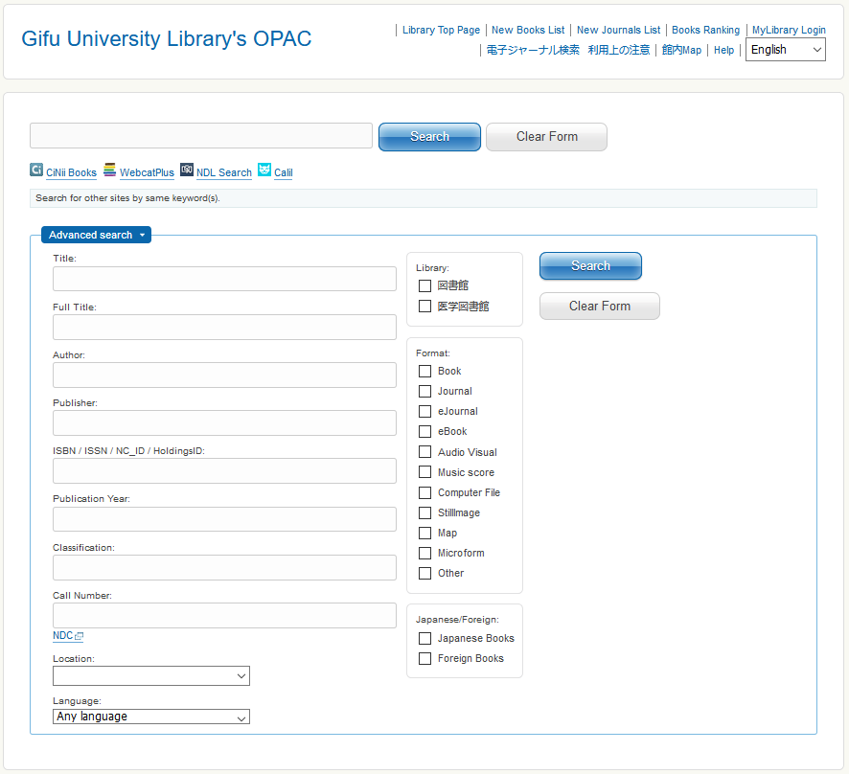
Library Book Search Engine（ＯＰＡＣ）
Information such as title, author and year are invalid here!
Title ：RAB-10 regulates glutamate receptor ・・・
Author ：Glodowski DR, Chen CCHほか
○Journal ：MOLECULAR BIOLOGY OF THE CELL
○Publisher：AMER SOC CELL BIOLOGY
Volume ：18(11)
Page ：4387-4396
Year ：NOV 2007
○ ISSN ：1059-1524
Effective items are:
・Title/word(journal)
・Full title(journal)
・Publisher
・ISSN
ISSN：
International Standard Serial Number.
ISSN of Journals and newspapers are fixed to 8 digits.
Notes:
When the PDF of the paper cannot be found on Scopus, check whether Gifu university has the desired papers or not. Please be aware that year of publishing, title of papers, author are invalid in OPAC search, the only effective items are title of journal, publisher and ISSN. In this journal the ISSN is 1059-1524.
If you search by the title of paper, it may show no result although the library owns the journal, so please be careful to the search item.
Now I try to search this paper.
Title of the journal is “Molecular Biology of the Cell.”

Slide 24
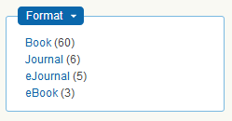
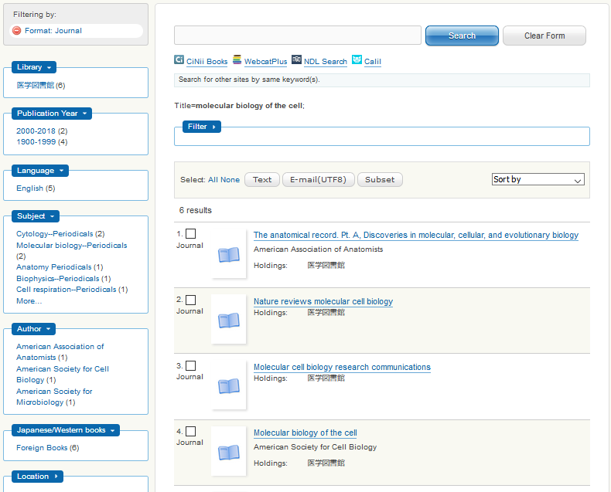
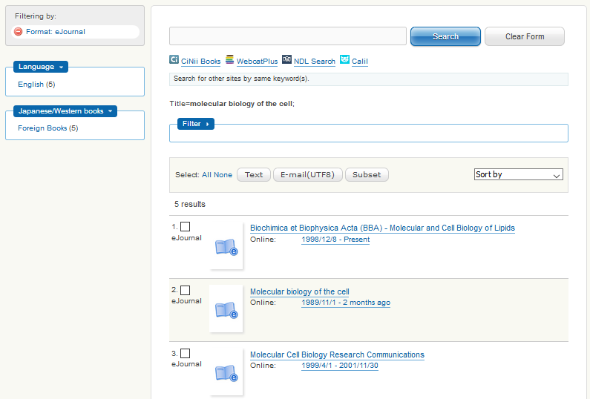
Library Book Search Engine（ＯＰＡＣ）
＜Journal＞
＜eJournal＞
Notes:
After entering the journal title in OPAC, select a magazine in format.
At the 4th line you can see the Molecular biology of the cell.

Slide 25
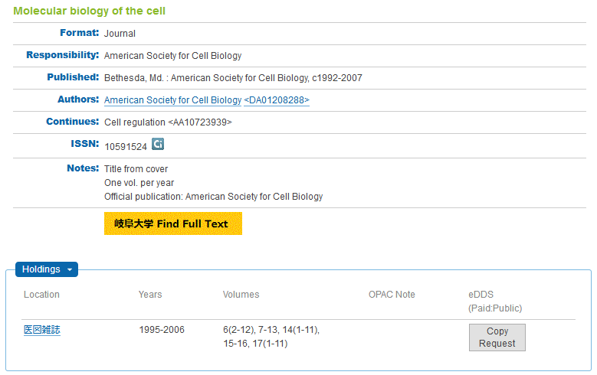
Find journals in library
Title ：RAB-10 regulates glutamate receptor ・・・
Author：Glodowski DR, Chen CCHほか
Journal ：MOLECULAR BIOLOGY OF THE CELL
Publisher：AMER SOC CELL BIOLOGY
Volume ：18(11)
Page：4387-4396
Published year&month ：NOV 2007
Do not forget the Holding Volumes!
In this example, 18(11) is not found in library.
Notes:
When you search journal in OPAC, please do not forget to check the holding volume number.
The Gifu University only possesses the Molecular Biology of Cell from volume 6 to 17, so I cannot get vol.18 no.11 in printed form at the library.
We will be explaining the procedure when desired volume of journal cannot be found in the library.

Slide 26
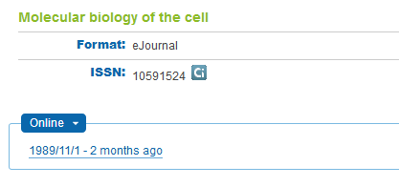
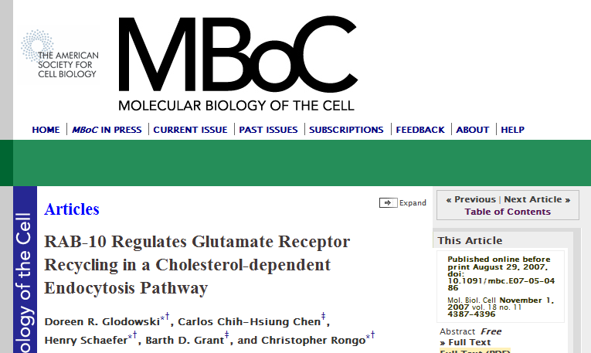
Electronic journal subscribed by library
OPAC details
Check available period
And Click the period
Electronic journal
Search by year, volume and page.
Notes:
Next, we will introduce how to search for electronic journals which are subscribed by the library.
In the previous slide, after opening「eJournal」choose the 2nd line.
You can check the available period and access from the “Online”

Slide 27
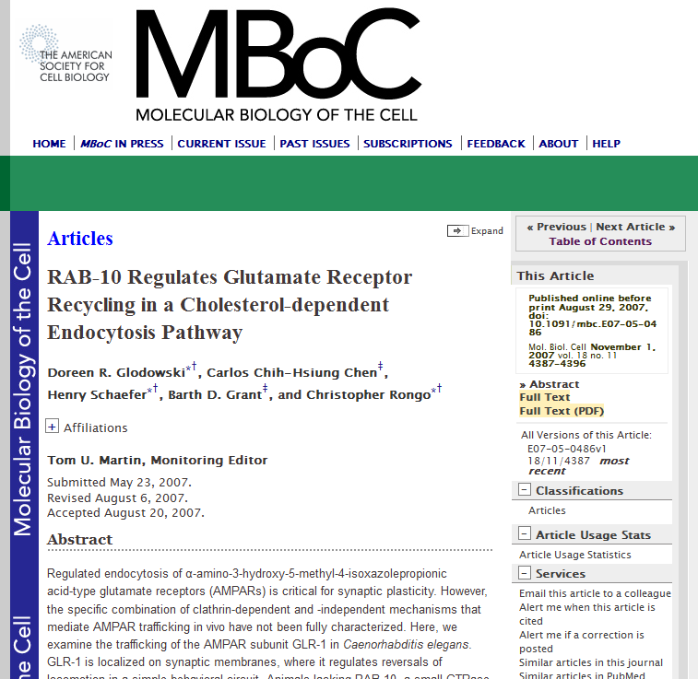
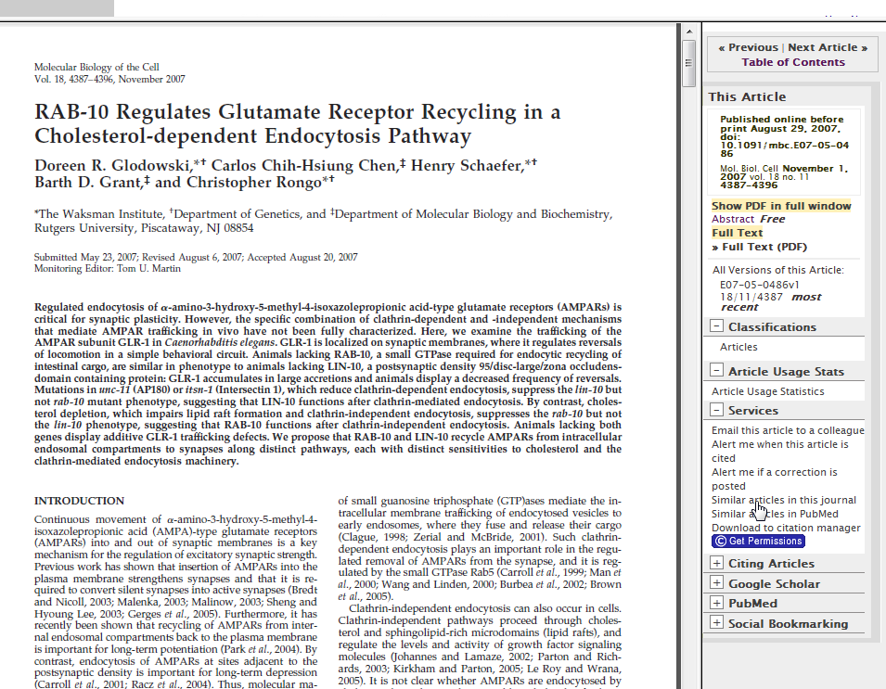
Click FULLTEXT（PDF）
PDF can be read, saved and printed.
Details about the paper is noted where the volume and page number is written.
Notes:
In the Electronic journal sites, search paper by volume and number.
Click the URL to access electronic journals, you can read full text and download PDF here.
You may also use OPAC to look for electronic journals comprised in electronic journals sites (such as Science Direct).
It's very convenient to look for electronic journals by accessing through OPAC.

Slide 28
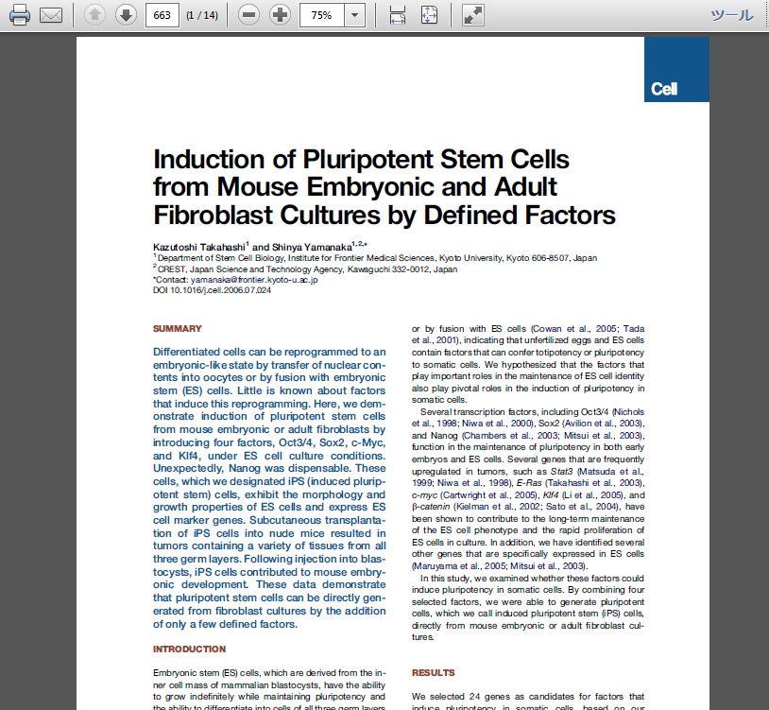
Link from database
Just like Scopus, in the database there are some papers contain links that can access to the original text.
If it is under contract with Gifu University the electronic journal is available for use.
Notes:
In Scopus, when there is a "View at Publisher" icon shown on top of the paper, you can access to this electronic journal by Internet.
Even if you do not come to the library, you can read the paper from the computer connected to the university network anytime.

Slide 29
Electronic journal sites
・Comprises digital version of most of the journals, using of papers are also possible.
※You can also use Abstract which is not in contract with university
・Not only can read the full text but also functions as a database.
・Only journals under the collection of the site can be found.
Notes:
Electronic journal sites contain digital version of many journals, so it functions as a database to search for papers.
But only journals under the collection of the site can be found, in another word, you are not guaranteed that all desired journals can be found on this site.
You can also read the full text if the journal you found is subscribed by the university.

Slide 30
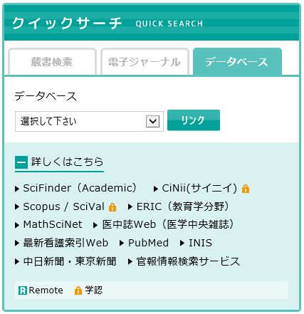
Electronic journal sites
Electronic journal sites
Notes:
Available electronic journal sites can be found on the web site of the library.
such as Science Direct, Wiley Online Library and SpringerLink.

Slide 31
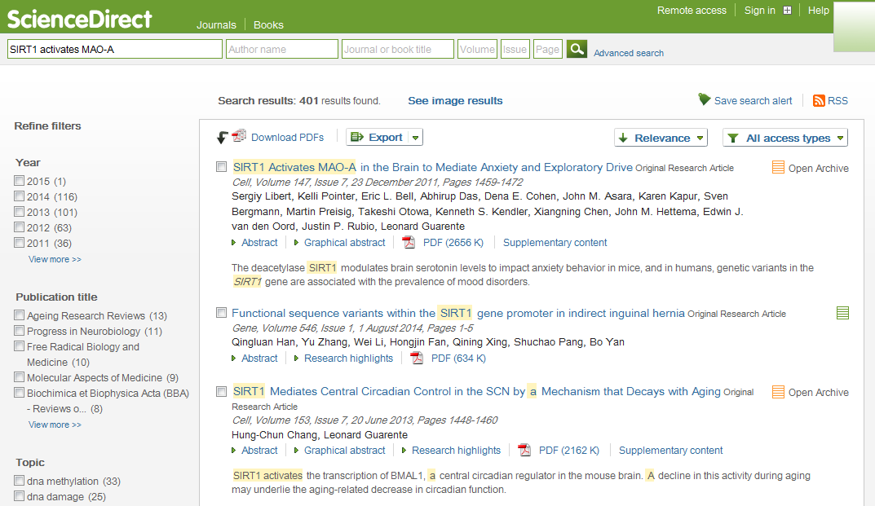
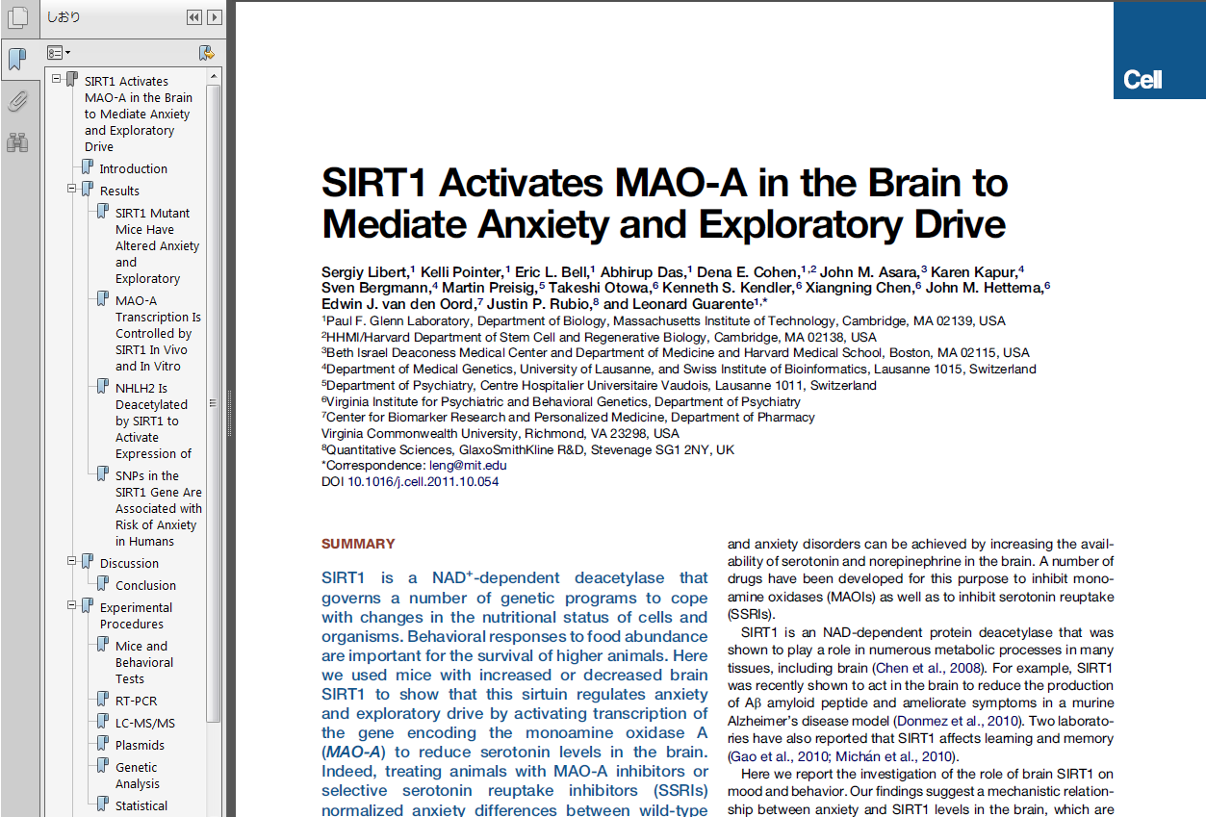
Electronic journal sites
Notes:
When you search paper in the electronic journal sites, you can read the contents if the journal is subscribed by Gifu University.

Slide 32
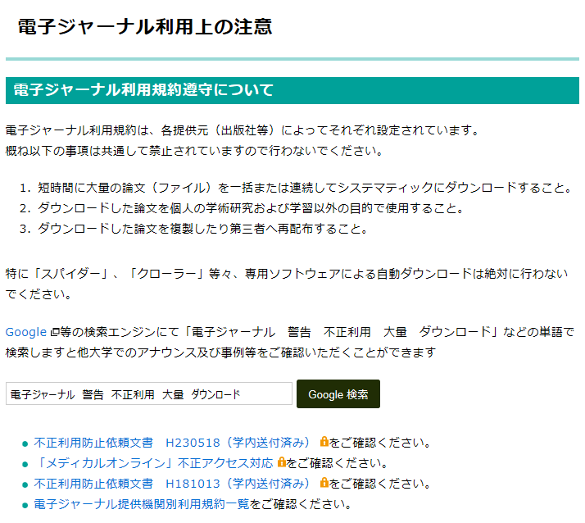

Attention when using electronic journal
If you do not comply with this rule, the whole university may be suspended.
Attention:
Download does NOT means SAVE PDF
Download means OPEN PDF
Notes:
This page is only written in Japanese but this information is crucially important.
Please do not open too many PDF files in short time while using electronic journals.
It will impose too much burden on the server and cause the whole system to stop working temporarily.
It is also prohibited to give PDF to people other than Gifu University.
If you do not comply with this rule, the whole university may be suspended.

Slide 33
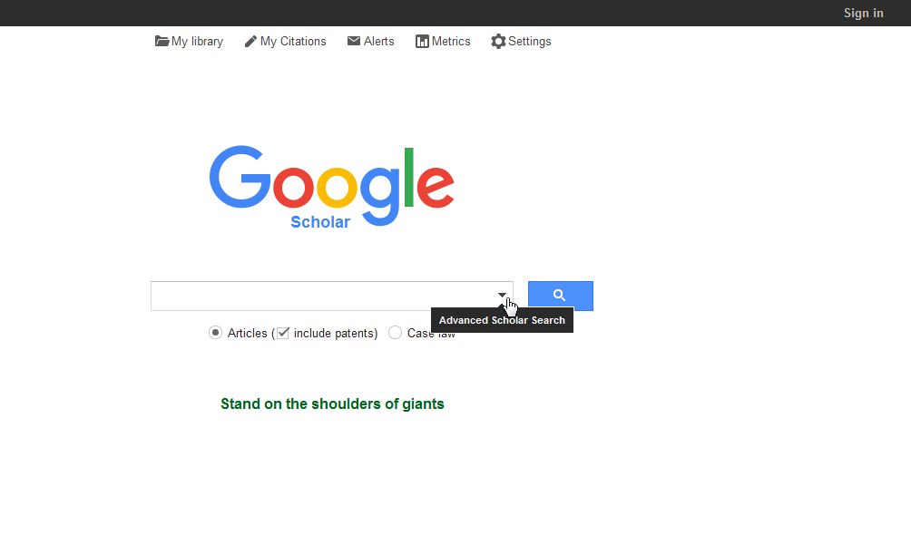
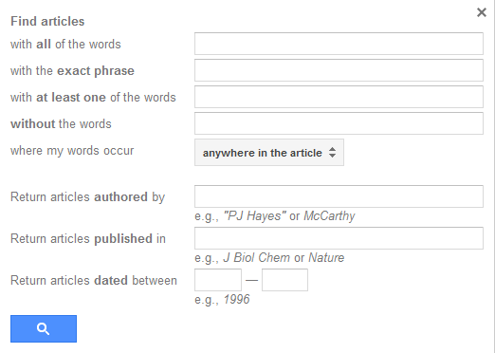
Ways to use Google Scholar(1)
http://scholar.google.com/
Click the Advanced Scholar Search for a more specific search.
Notes:
Scopus can be used via the university, whereas GoogleScholar can be used outside the university and it’s free of charge.
The way of using it is the same as using Google, for searching by advanced options like author, journal or published year the 「Advanced Scholar Search」can be used.

Slide 34
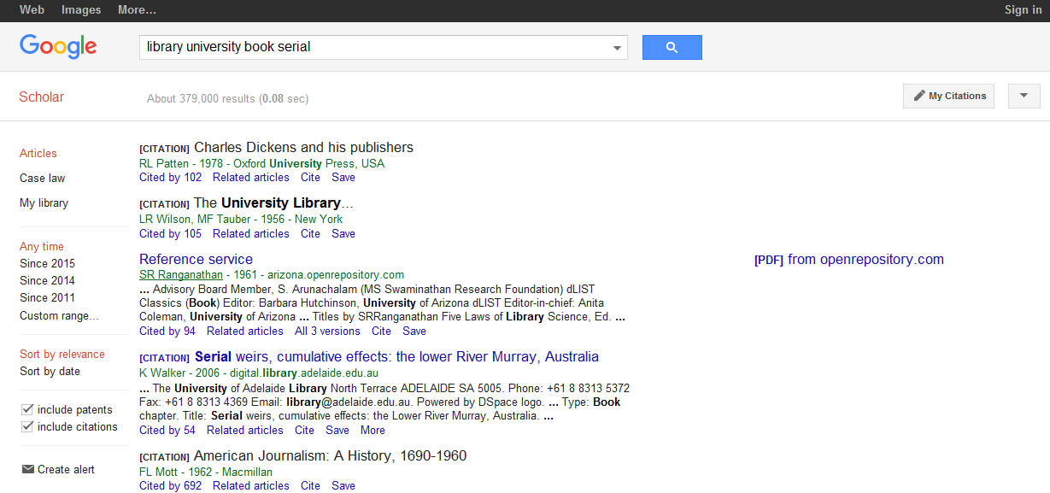
Ways to use Google Scholar(2)
When [PDF] is written PDF can be read.
Be aware that it can be an invalid copy for quotation.
Please get a publisher copy to avoid copyright issue.
Notes:
When there is a PDF version you may read it freely, but be aware that it can be an invalid copy for quotation.
Please get a publisher copy to avoid copyright issue.

Slide 35
Actual Practice
What you will need to do in order to get the research papers listed below?
(Printed version or digital version）
①Ruotolo BT, Giles K, Campuzano I, Sandercock AM, Bateman RH, Robinson CV. Science 2005, 310, 1658
②Davidson, R.J. (1993). The neuropsychology of emotion and affective style. In M. Lewis & J.M. Haviland (Eds.), Handbook of emotions (pp.143-154). New York: Guilford.
Notes:
We would like you all to start practicing how to find out the source of research papers by using the information provided. Printed version or digital version will do.

Slide 36
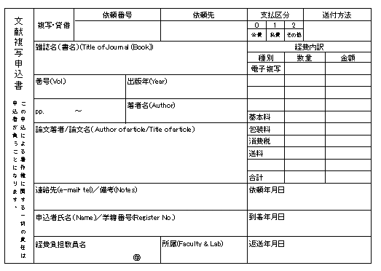
How to get papers from outside the university
Papers that cannot be found in library can be requested
  Book⇒Rental・Not more than half of the photocopy
  Journal⇒Photocopy only(not more than half of one paper for the latest volume)
Registration carried out at counter or through website.
Fees⇒Photocopy fee(Black and white1 piece for 35～50Yen）and postage fee
Time required⇒About 1 week
Registration form for copies of paper
Notes:
It's possible to get papers which cannot be found neither through library of Gifu University nor through electronic journal sites.
Information and references of library other than Gifu University can be obtained through CiNiiBooks.
In the case of books, you can request the actual books or not more than half of the photocopies of the book.
Only not more than half of the photocopies can be taken because copies of more than half or the book requires the consent from the author.
In the case of journal, most of them cannot be borrowed out of the library thus it is impossible to get the actual journal through the library, but you are allowed to request the photocopies of desired research papers.

Slide 37
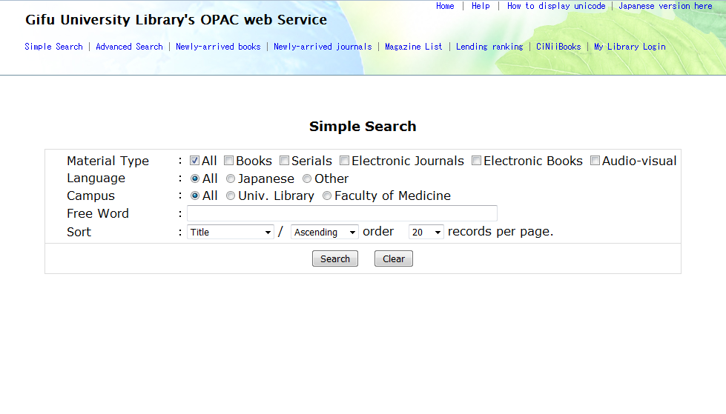
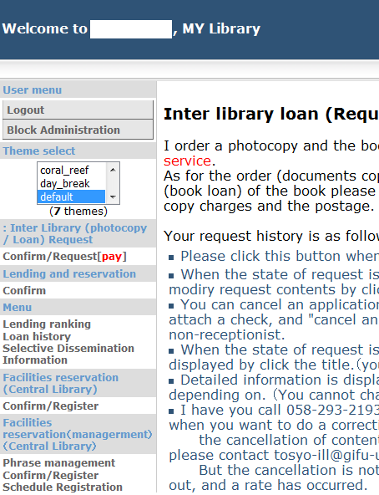
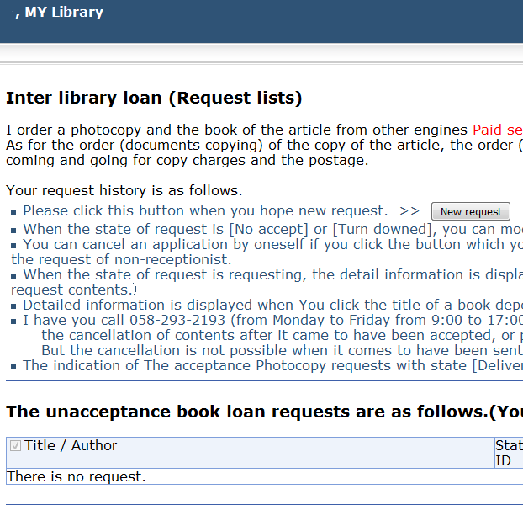
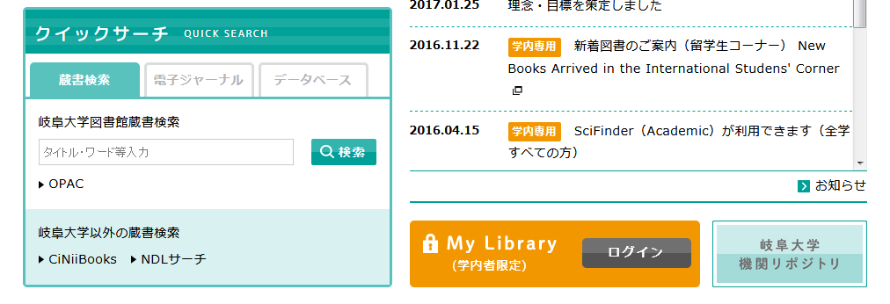
Registration from website
Log in to「My Library」.
Register through「Inter Library (photocopy/Loan) Request」.
Notes:
From the homepage of library, click the photocopy request (ILL) which is located under My Library.
In the case of accessing through OPAC, click the My Library log in and key in the username and password as usual.

Slide 38
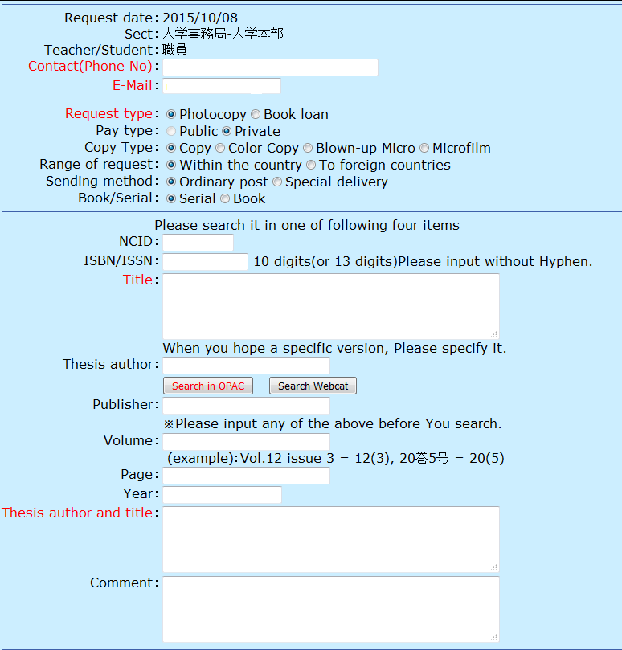
Registration from website
Place to key in the information.
Notes:
You can apply for request through this page. Key in the actual information, click the "confirm" button to complete the request.

Slide 39
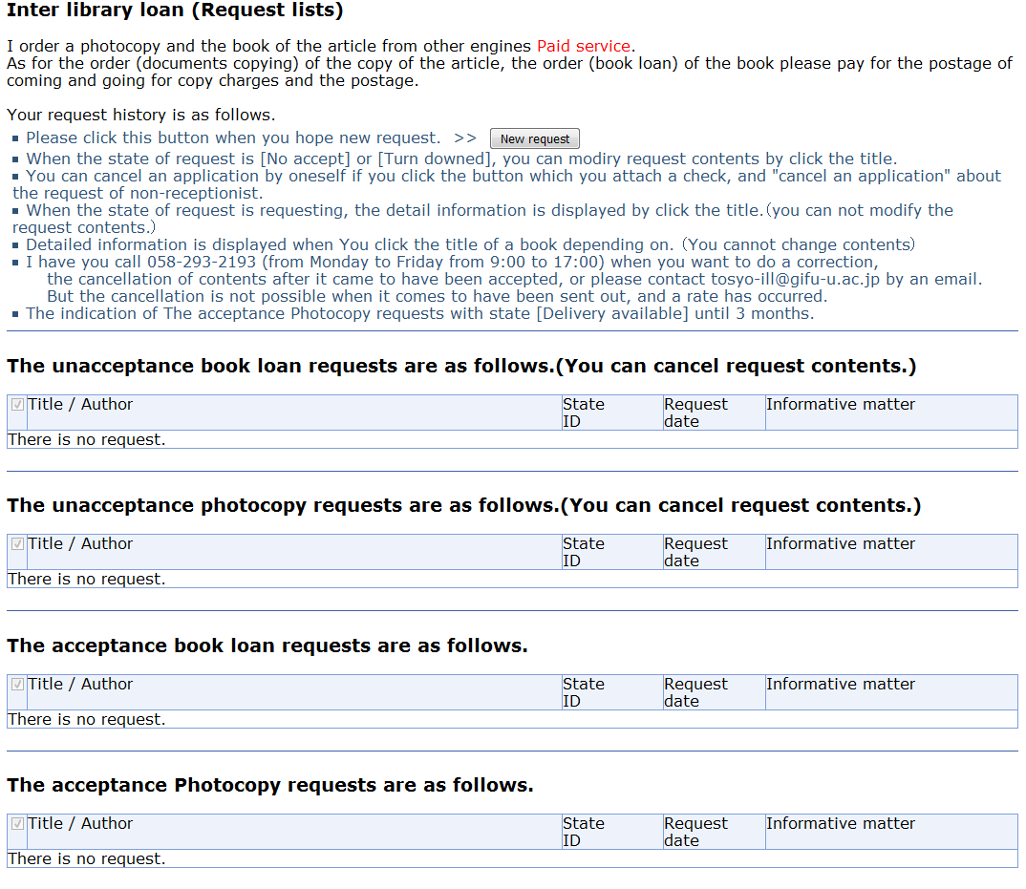
Registration from website
依頼状況確認の画面
Notes:
The status of request can be checked through request list. Message like the arrival of photocopies or cancellation of request will be uploaded on this page.
Please check the page frequently to keep yourself updated to the status of request.
To get the reference, in the case of personal expense, pay the fees at the library before you get it. For medical faculty's students, please pay at library of medical faculty.
In the case of public expense, the reference will be sent directly to the teaching supervisor.

Slide 40
Lastly...
Feel free to ask our staffs if you have any enquiry!
Counter: Monday to Friday 9:00~17:00 (staffs always here)
Phone number: 058-293-2191 (time as above)
Email address: tosyo-ill@gifu-u.ac.jp
Notes:
This is the end of this course. If there is any enquiry please feel free to ask our staffs about it.

